Slide 1
Cooperative Society Membership and Savings Management System
Presented by – S. Pranathi
Class/Sec – AIML Panthers
Roll no. – 25WU0104024
College – Woxsen University

Slide 2
Problem Statement
Manual records make member and savings balances difficult to verify.
Need a centralized database for members, shares, savings, loans, dividends, meetings and nominations.
A Cooperative Society Membership and Savings Management System solves the problem of manual, error-prone record- keeping for member registrations, monthly savings deposits, share capital tracking, and loan distributions in a local cooperative.
Manual Record-Keeping: Paper registers and basic spreadsheets cause data loss, calculation errors, and missing transaction histories.
Delayed Tracking: Members wait days to know their exact savings balance or loan eligibility.

Slide 3
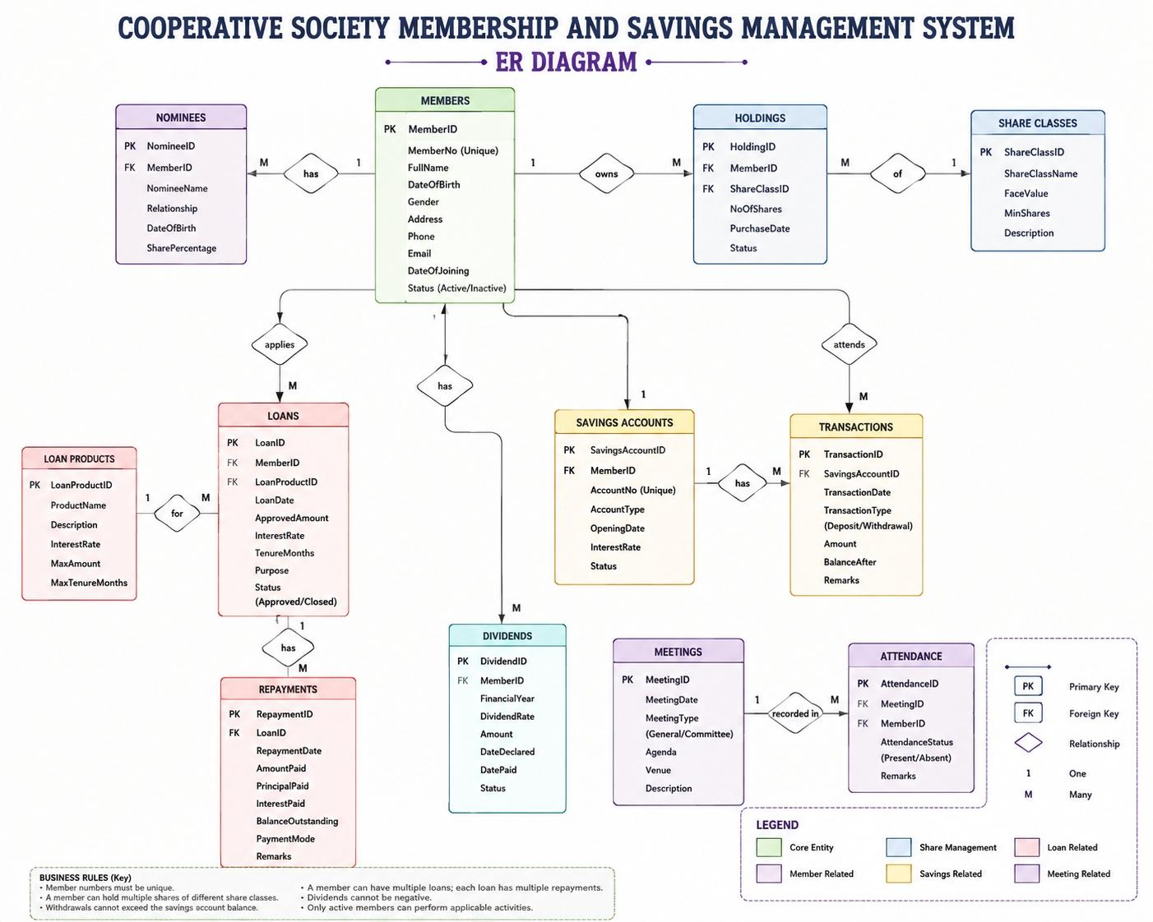
Er Diagram

Slide 4
Main Entities
Members
Nominees
Share Classes
Holdings
Savings Accounts
Transactions
Loan Products
Loans
Repayments
Dividends
Meetings
Attendance

Slide 5
Objectives
Maintain accurate member records
Track shares and savings
Manage loans and repayments
Improve data accuracy and accessibility
Generate useful reports
Maintain data integrity

Slide 6
Conclusion
The proposed DBMS provides an organized way to manage cooperative membership and savings-related activities.
A Cooperative Society Membership and Savings Management System successfully modernizes traditional financial cooperatives by automating member registration, secure savings tracking, and transparent loan workflows.

